Slide 1




Chargeless Advertisement tool
SOFTWARE ENGINEERING DEPARTMENT
Ort Braude College
Capstone Project Phase A – 61998
Share2Grow
24-2-D-16
Supervisor:
Zakharia Frenkel
Authors:
Abed Tayar
Abed.tayar@e.braude.ac.il
Mahameed Egbaria
Mohameed.egbaria@e.braude.ac.il

Slide 2



Introduction
1- marketing costs are on the rise.
2-Share2Grow
3-A friend brings a friend

Slide 3
Problem Description
High Marketing Costs.
Limited Reach in Traditional Marketing.
Lack of Effective Tracking and Insights.
Trust and Security Concerns.

Slide 4

Solution Description
1.Free Referral-Based Marketing.
2.Viral "Word of Mouth" Marketing Model.
3.Link Tracking and Precise Insights.
4.Security and Trust via IP Tracking.
5.Support for Small Businesses and Startups.
6.Advanced Search and Sorting System.
7.Earning Opportunities for Customers.
through Link Sharing

Slide 5





Client-Server Technologies:
Firestore stores and syncs data for web and mobile apps, real-time.
Technology that helps build web servers and APIs with routing, middleware support.
React builds user interfaces with reusable components for dynamic web apps.
Node.js runs JavaScript on servers for building scalable web applications.

Slide 6




Front-End Technologies
React:
We will use React.js, a popular JavaScript framework for building user interfaces
Bootstrap
We will use Bootstrap for design our web.
Css
CSS is instrumental in styling our website.

Slide 7



Back-End Technologies
Express.js:
Express.js is a web application framework for Node.js. It simplifies building web servers and APIs by providing tools for handling HTTP requests, routing, and middleware integration.
Node.js:
Node.js is a runtime environment that allows you to run JavaScript code on the server side.
FireStore:
Firestore is a NoSQL cloud database from Google Firebase that allows you to store and sync data in real time image storge and user details.

Slide 8




APi’s
Firebase:
Firebase API is a set of tools and services provided by Firebase that allows developers to build, manage, and scale web and mobile applications.
IP Geolocation:
This service allows for the identification of the user’s IP location, including details such as city, country, time zone, and ISP.
WordPress:
The WordPress REST API allows for interaction with WordPress sites programmatically.
Algolia:
Algolia API provides a powerful search and discovery engine that enables fast and relevant search capabilities across large datasets.

Slide 9
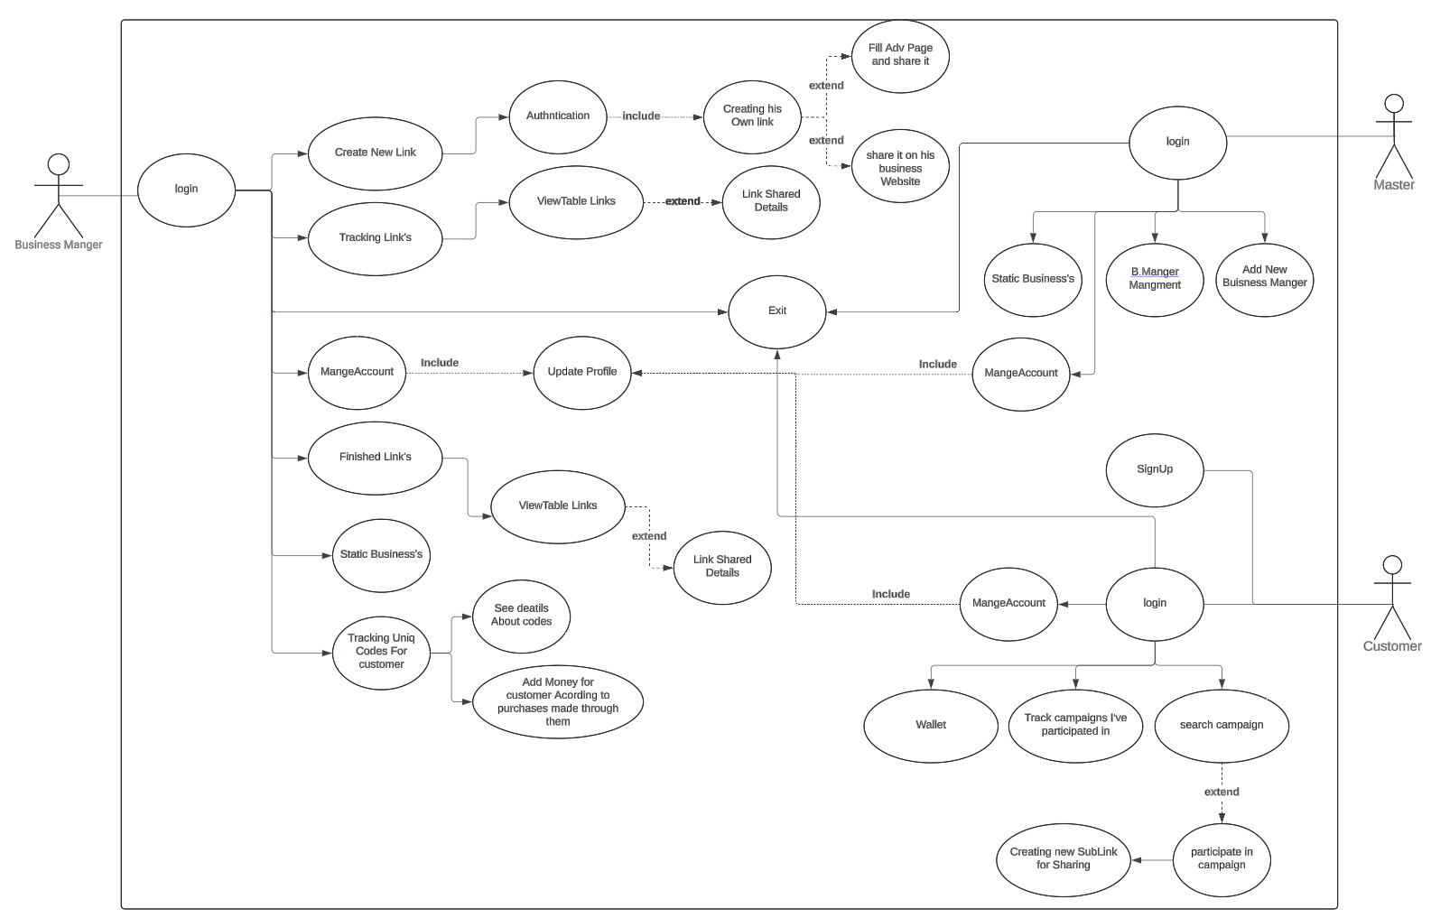
Use Case Diagram

Slide 10
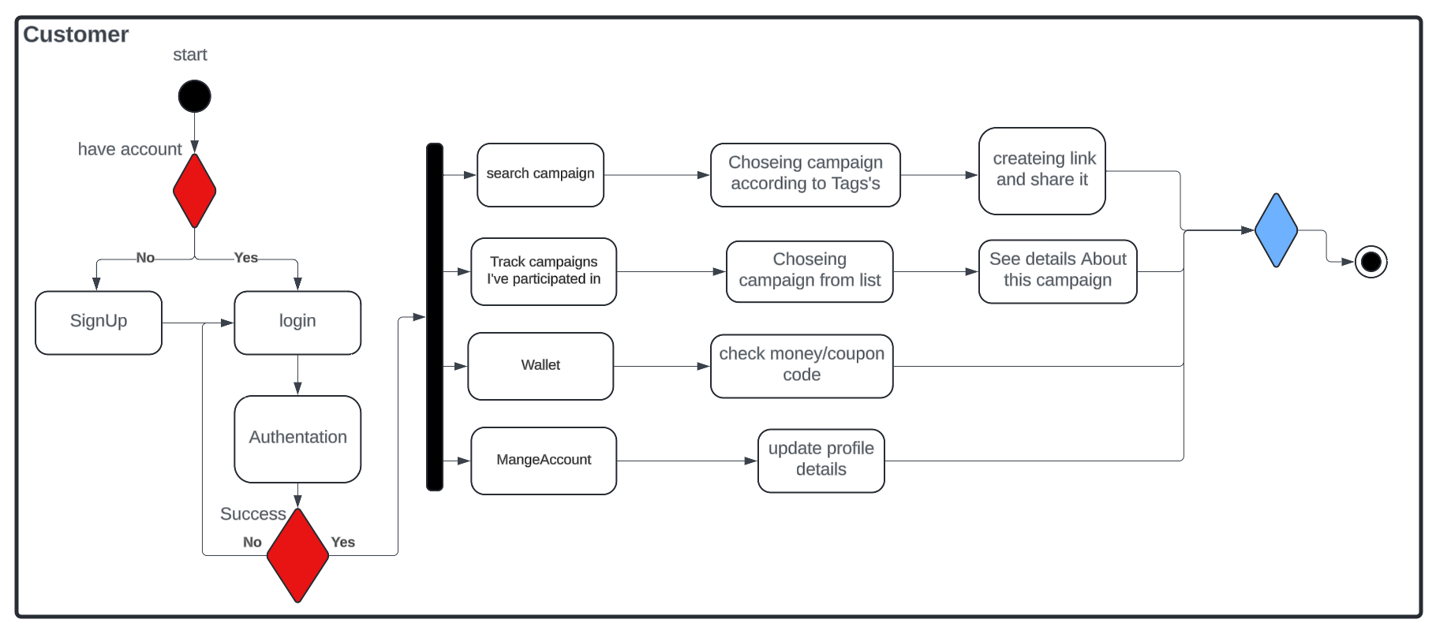
Activity Diagram

Slide 11
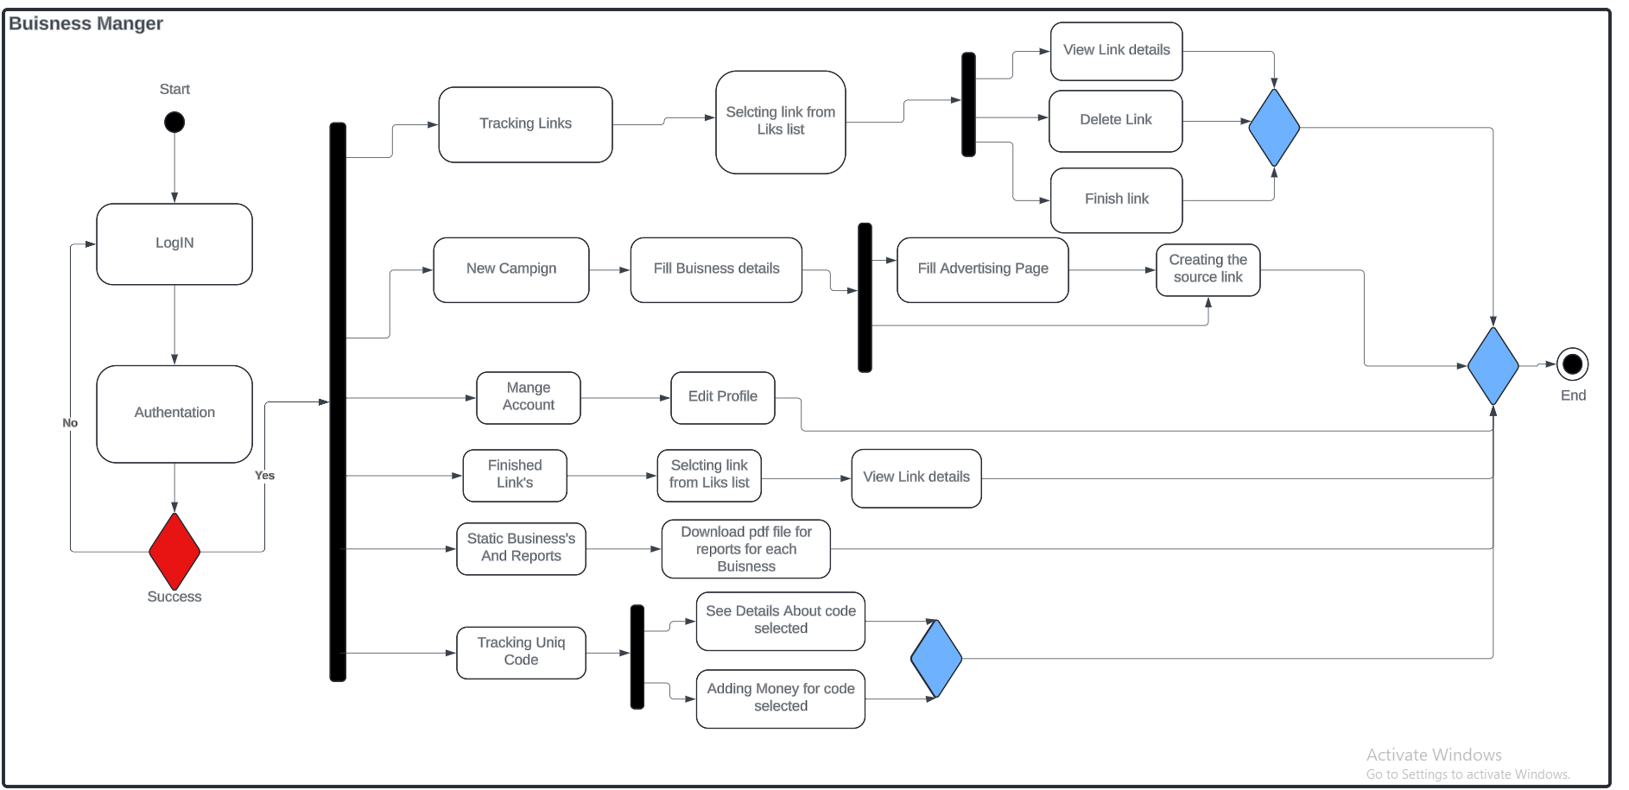
Activity Diagram

Slide 12
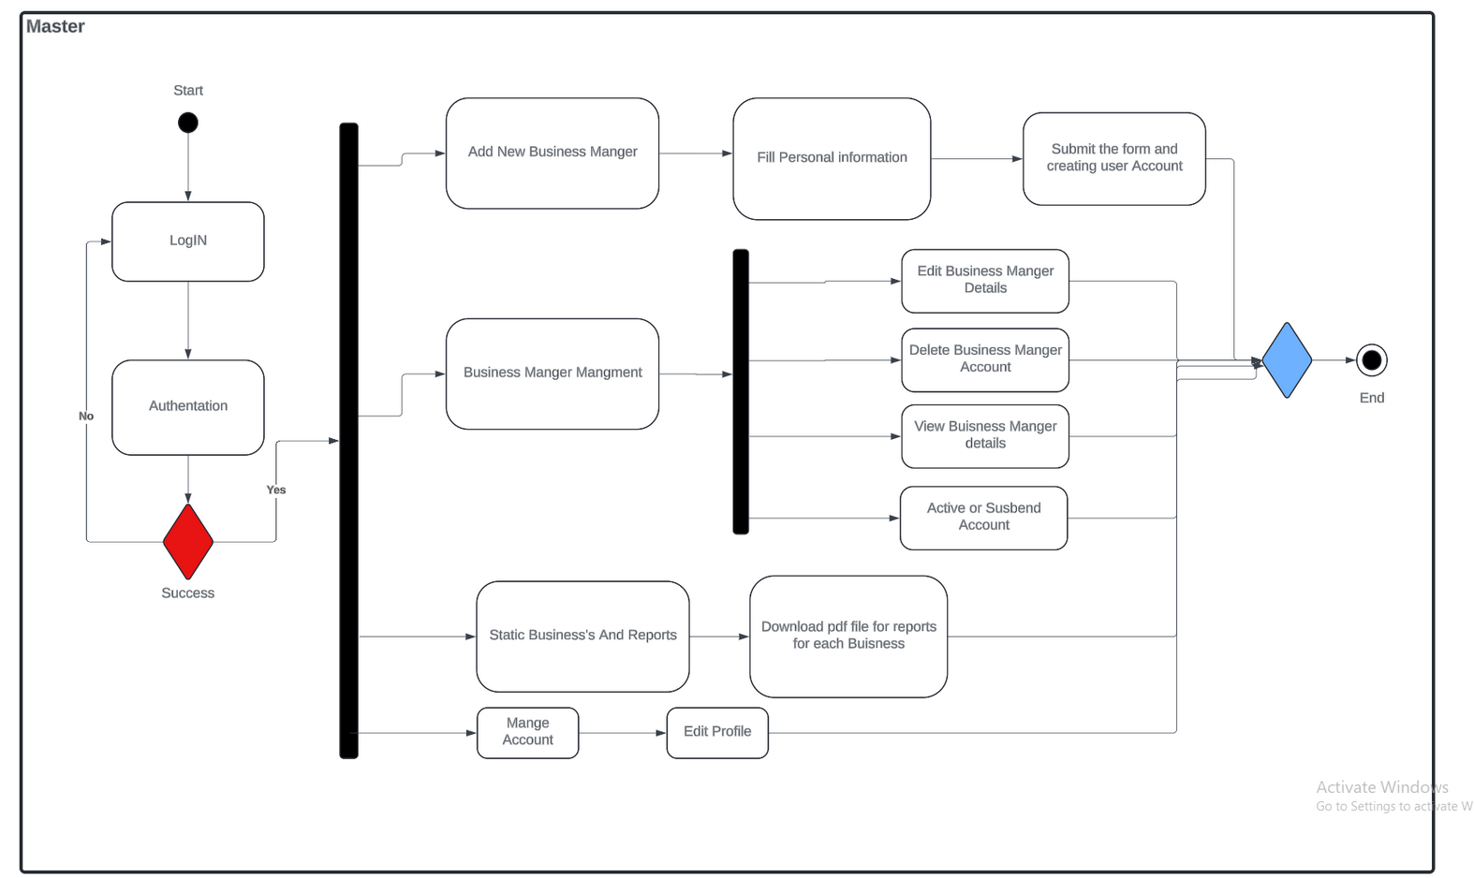
Activity Diagram

Slide 13
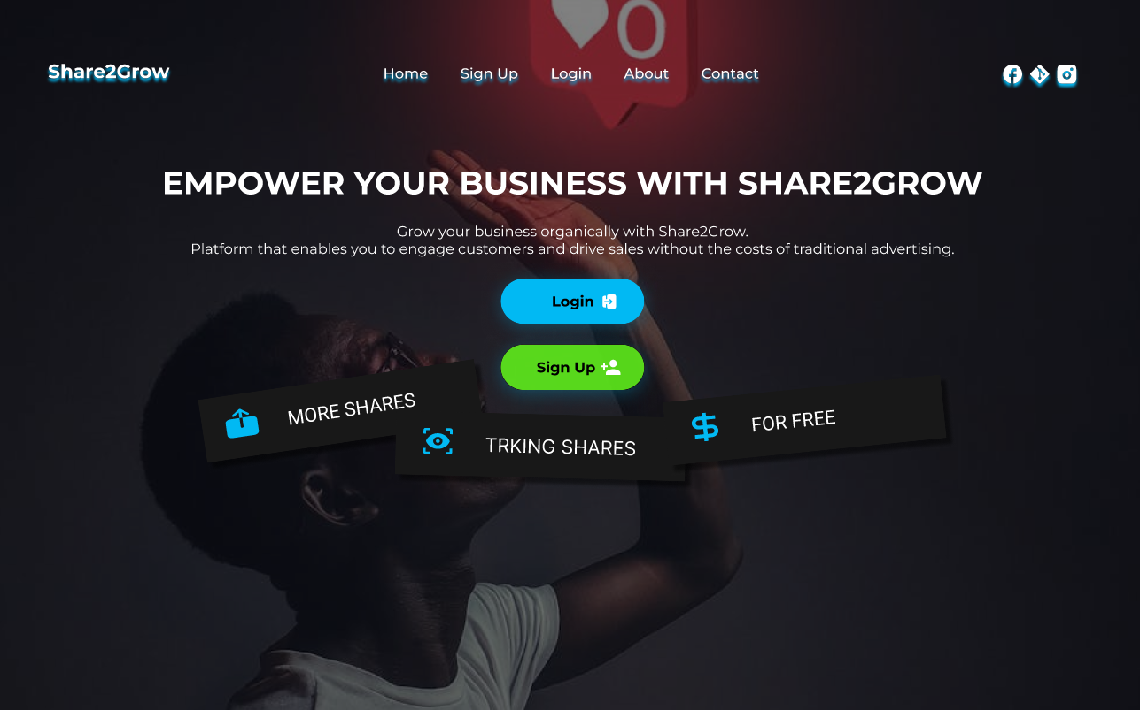
Our website screens:
Home Page:

Slide 14
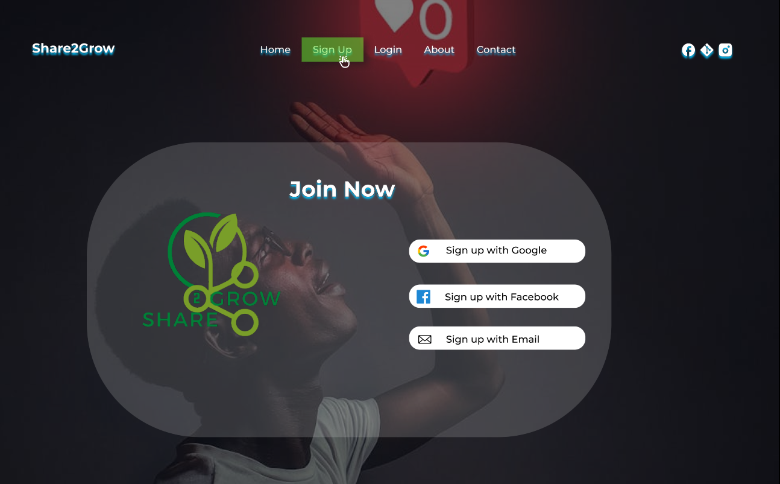
Our website screens:
Sign up:

Slide 15
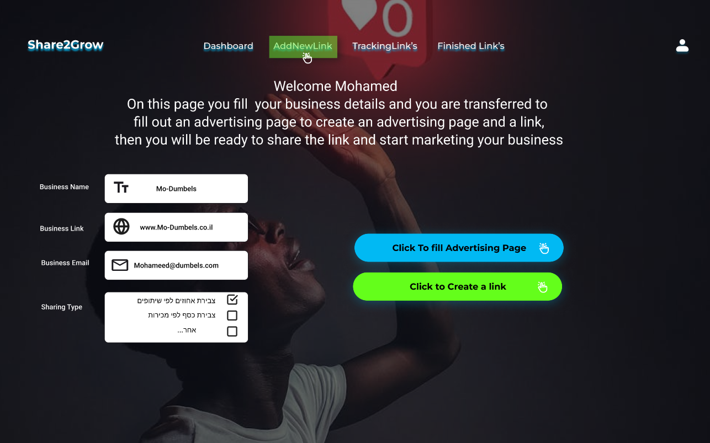
Our website screens:
Add new Campiagn at buisness manager page:

Slide 16
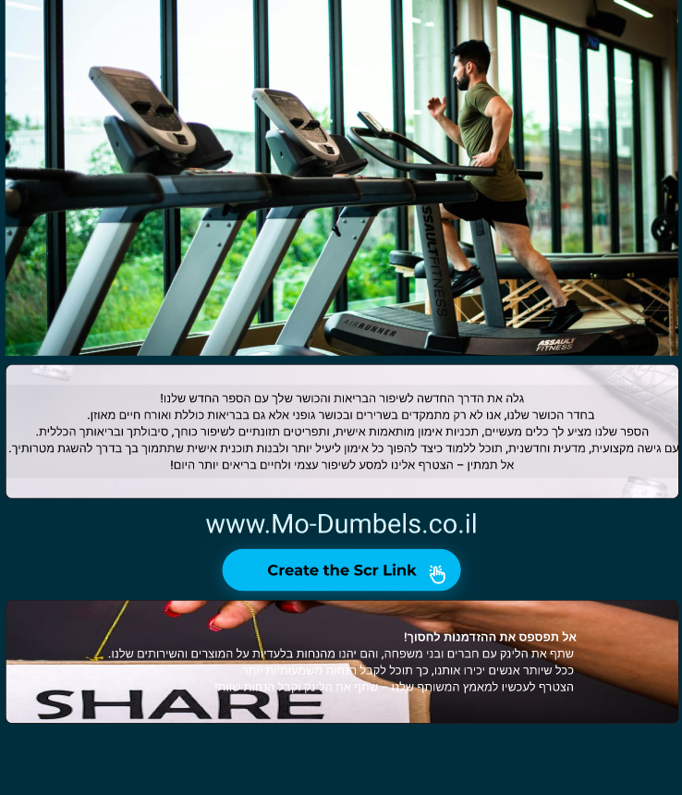
Our website screens:
Advertaisment Page:

Slide 17
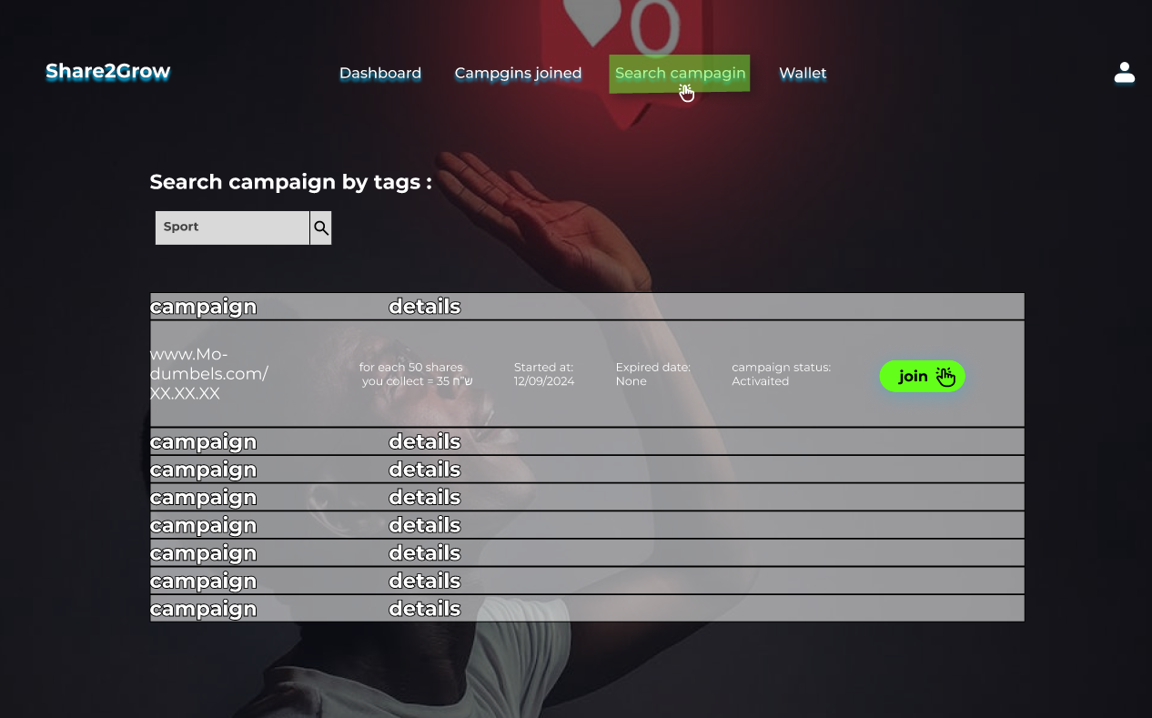
Our website screens:
Customer account search campaign:

Slide 18
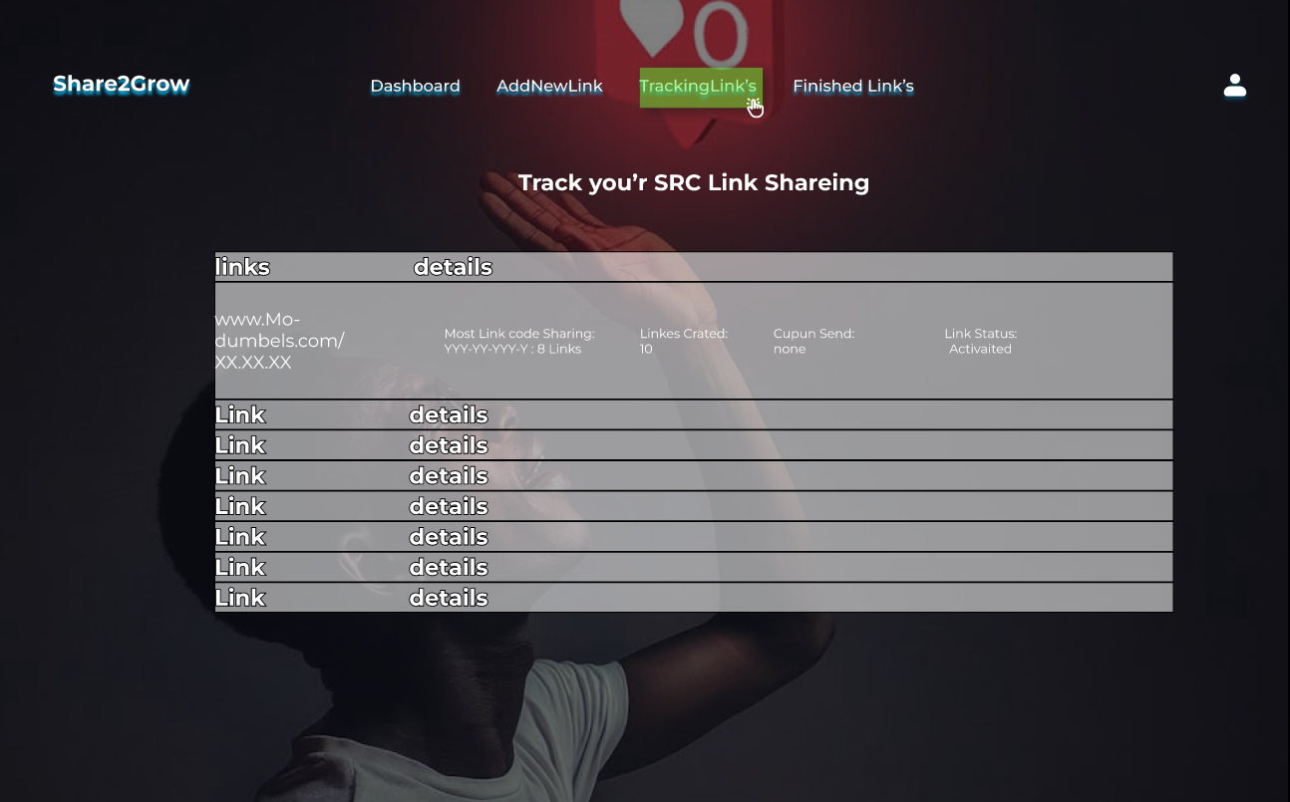
Our website screens:
buisness manager page tracking Links

Slide 19
Unit Tests Some Example
#No​ | Test Subject​ | Expected result​
Login form​ | Login form​ | Login form​
1​ | Enter an empty username or password​ | Error displays a message: “Please fill in the fields”.​
2​ | Enter the wrong username or password​ | Error displays a message: “Invalid details, try again”​ We don’t want to give information about which field is invalid.​
3​ | Log in with a ‘frozen’ status username and password​ | Display message: “User is Frozen”.​
4​ | Enter a valid username and password​ | Display message:” Login succeed”.​

Slide 20

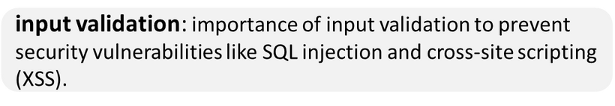

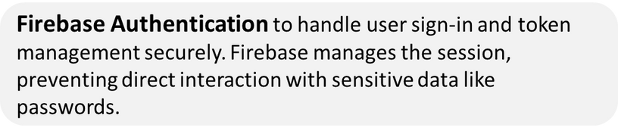
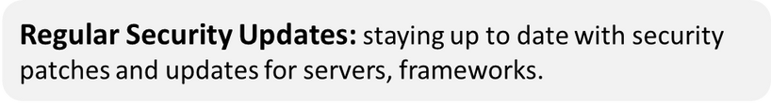
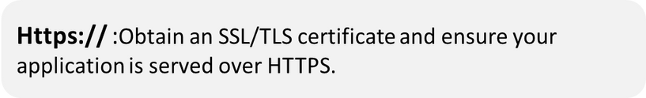

Website security:

Slide 21

Thanks for attention

